Slide 1
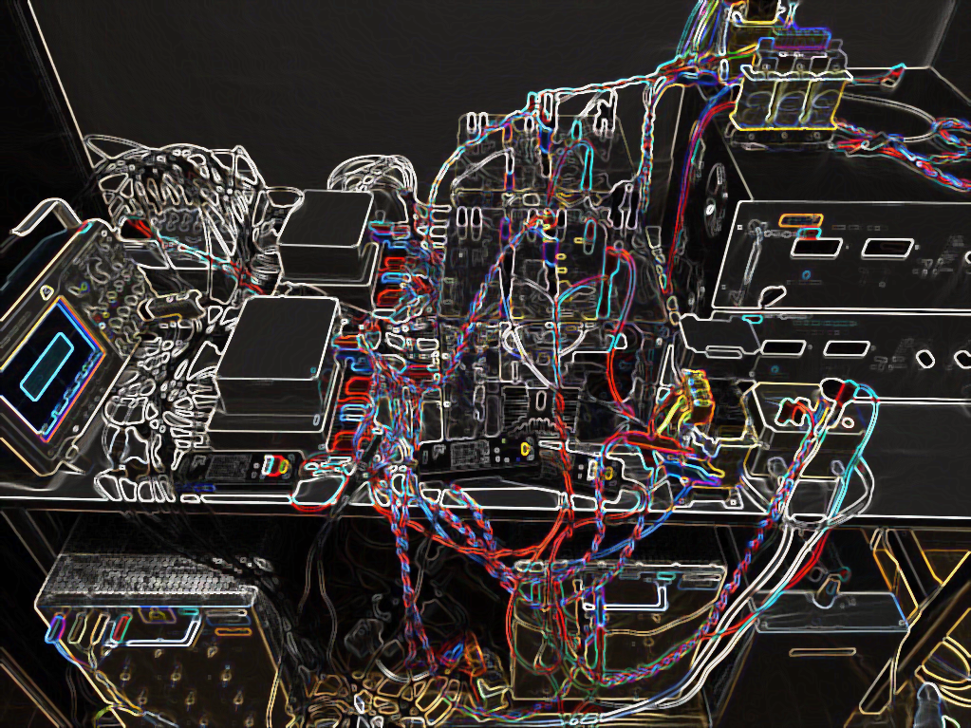
Neural network-based imitation of model predictive control for power converters
Aitor Teran, Cristina Roche, Pere Izquierdo

Slide 2
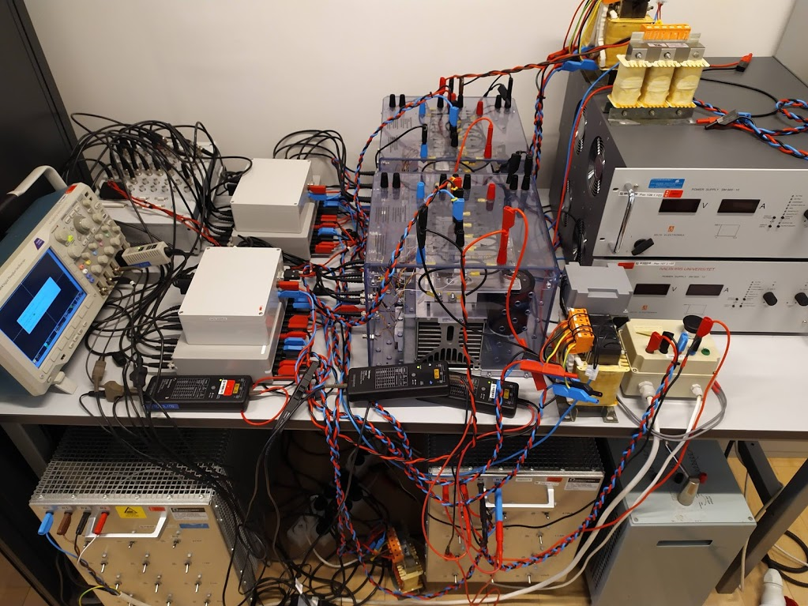
CONTENT
FS-MPC
ANN IMITATOR METHOD
RESULTS
CONCLUSION

Slide 3
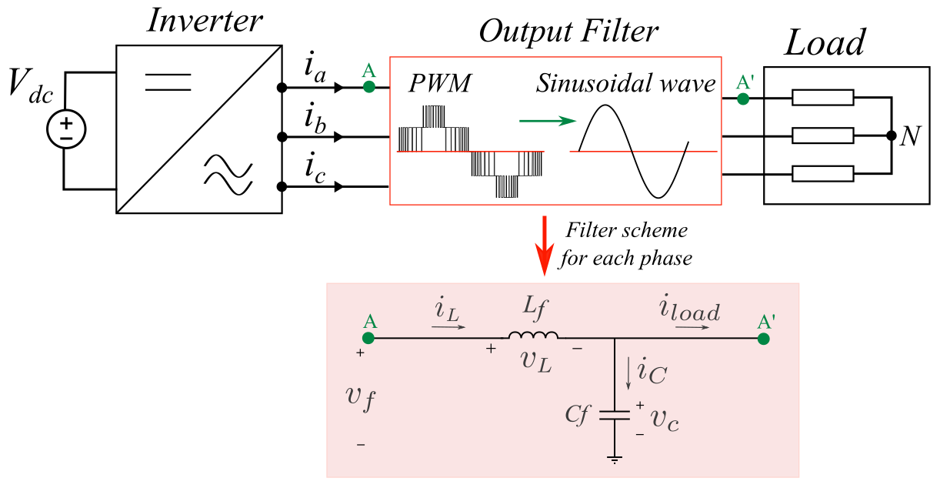
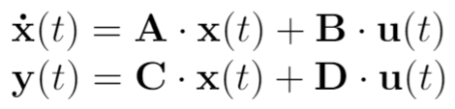
MODEL
Notes:
The classic. Traditional 2-level inverter with LC output filter.
Discretized state-space model.

Slide 4
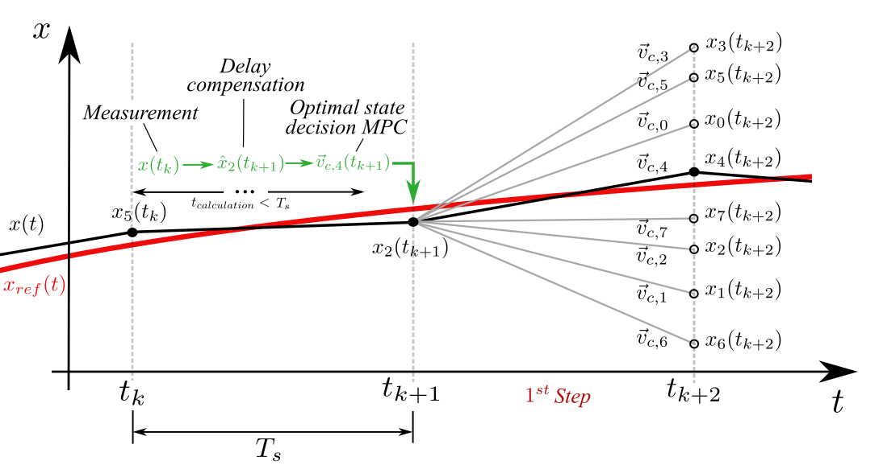
FS-MPC
Algorithm that uses the model of the system to predict the control action that minimizes error.
Optimal decision
Notes:
FS-MPC stands for finite-set model predictive control.
Model predictive because it makes use of a model of the system to compare predictions to references, finite-set because there’s a limited number of control outputs.
Explain the figure.
Disadvantage: computational requirements.

Slide 5
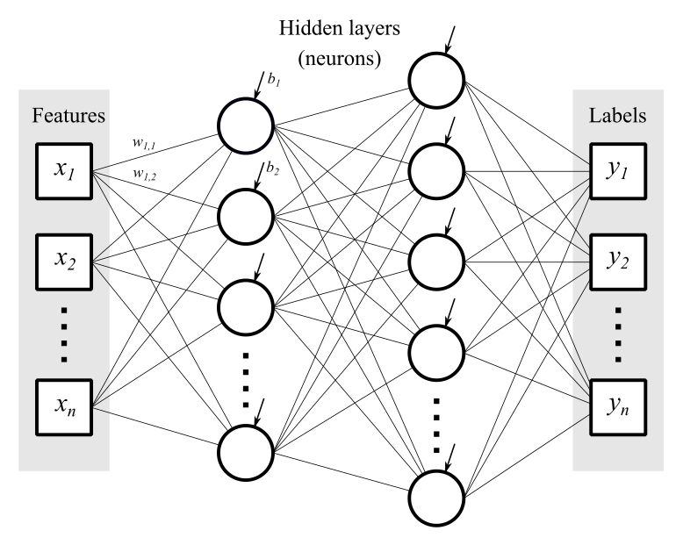
PROPOSED SOLUTION
Inputs
Outputs
Low computational burden.
Ability to imitate different controllers.
Notes:
The proposed solution is to use a neural-network-based imitator.
A neural network is computationally cheap universal approximator.
Neural network basics: each neuron computes previous values times weight vector and adds a bias value, then going through a nonlinear activation function.

Slide 6
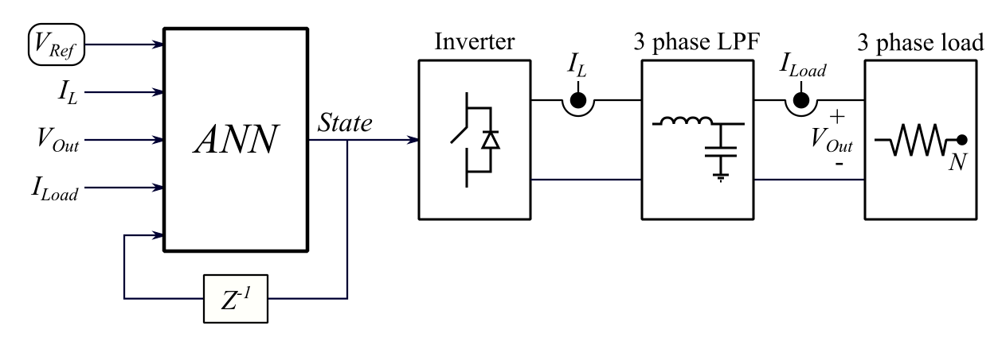
DATA ACQUISITION
2 million training data points
1 million random validation and test data points
Notes:
Explain the control scheme. Inputs: reference voltage, output voltage, inductor current, load current, previous system state.
Network trained using TensorFlow in Python using 2 million grid-generated data points within the operating range of the lab setup.
Validation and testing of the neural network performed on 1 million random data points inside the same bounds.

Slide 7
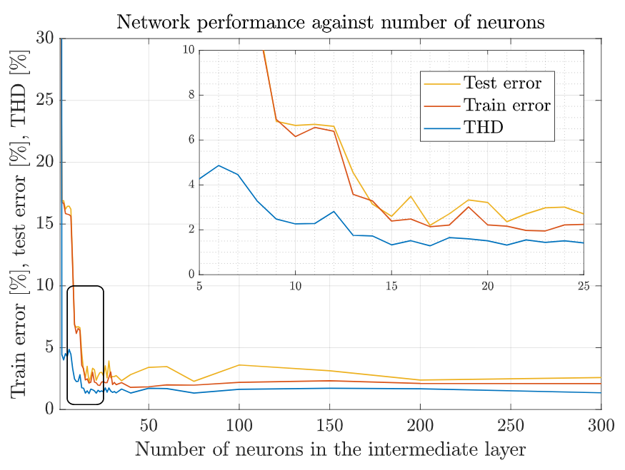
TRAINING THE NETWORK
Finding the optimal network configuration.
1 hidden layer with 15 neurons.
98% test accuracy
Notes:
Finding network configuration: activation functions, cost function, optimization algorithm. Non-convexity of training a neural network.
Adding several layers does not significantly improve the performance of the network.
For a single layer, error and THD values are compared to obtain the optimal number of neurons.

Slide 8
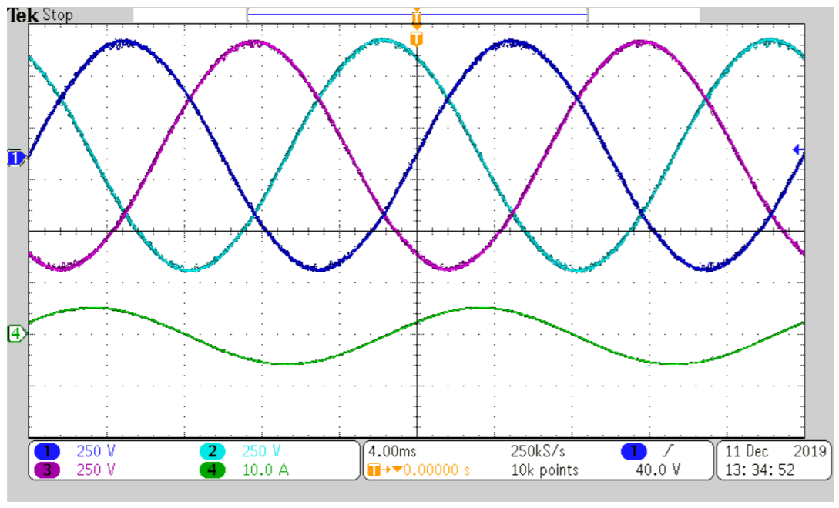
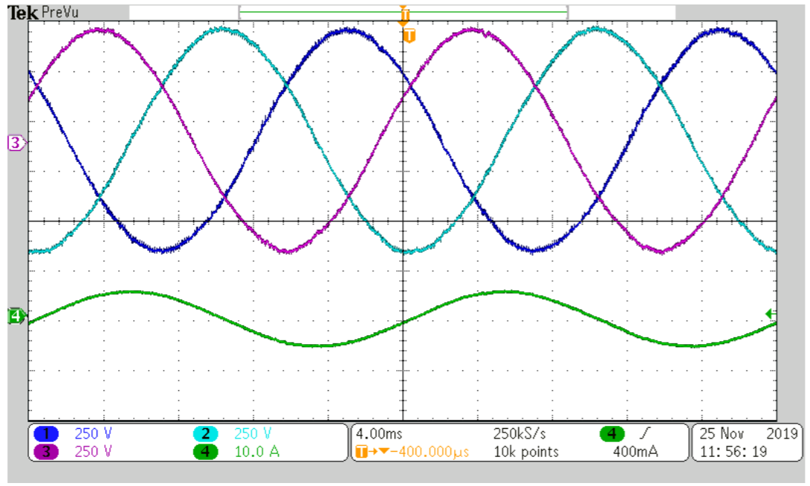
RESULTS
MPC
Why is the same figure shown twice?
ANN
Notes:
This slide shows how good the ANNs are at approximating MPC.
Very similar THD and switching frequencies.
1-step MPC takes 10 us, 2-step takes 13 us. ANNs always take 11 us.

Slide 9
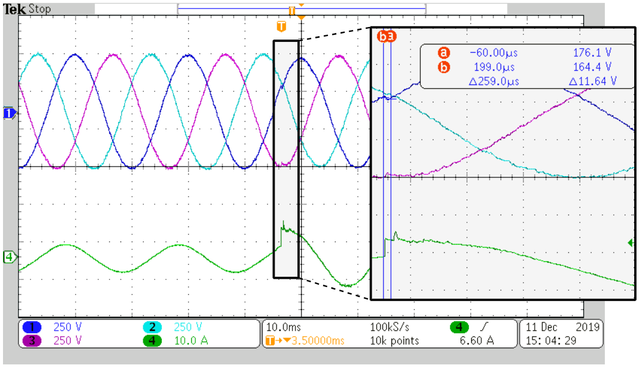
RESULTS
Imitator transient response
Notes:
Fast and accurate load transient response.
Current spike because of switching device.

Slide 10
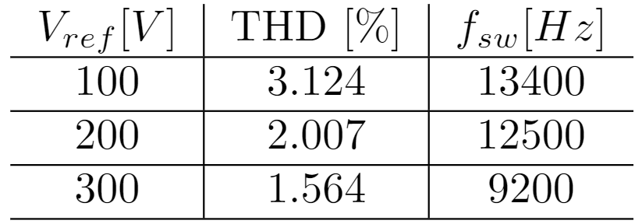
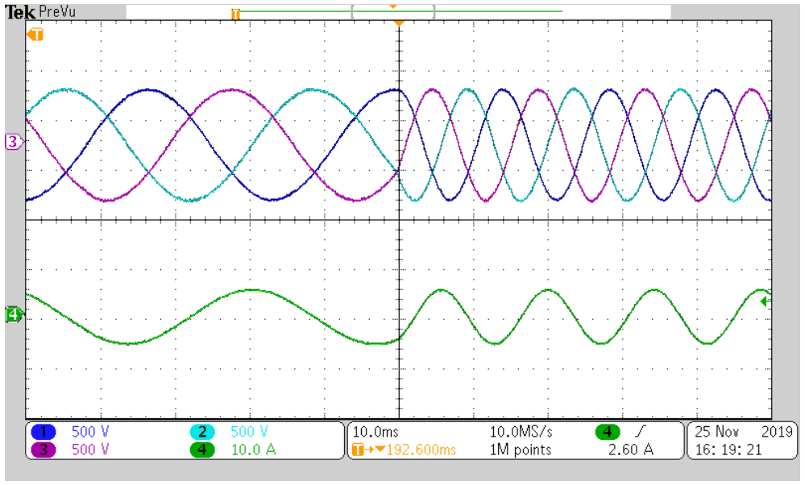
RESULTS
Imitator robustness
Ability to extrapolate to untrained data
Robust to voltage reference changes
Notes:
Surprisingly, the imitators are robust to changes in reference voltage amplitude and frequency, even though they were not trained for it.

Slide 11
CONCLUSION
The imitation method removes the computational limitations of FS-MPC, while maintaining its performance.
ANNs show great potential for application in the field of power electronics.
In principle, the method could be used for any control scheme.
Notes:
Surprisingly, the imitators are robust to changes in reference voltage amplitude and frequency, even though they were not trained for it.

Slide 12

THANK YOU
THANK YOU

